Slide 1


DEPI
GENERATING TEXT FROM IRISH LYRICS
Presented by
Khaled Said
Keroles Adel
Refaat Khaled
Ahmed Adel
Mohamed Saleh
Hatem Mohamed

Slide 2

PROJECT OVERVIEW
Purpose of Project :
To generate authentic, stylistically Irish song lyrics by training an RNN-based model on a dataset of Irish lyrics.
Scope of Work:
NLP preprocessing steps
Model architecture and hyperparameter tuning
Evaluation of output and limitations

Slide 3

OBJECTIVES AND MOTIVATION
Objectives:
Use machine learning to learn patterns in Irish lyrical data.
Generate coherent text that reflects Irish song styles.
Motivation:
Cultural preservation through technology.
Exploration of deep learning capabilities in creative text generation tasks.

Slide 4

KEY CONCEPT
Data Collection and Description
Potential Improvements
Data Preprocessing
Model Architecture Overview
Training Process and Model Performance
Challenges and Limitations
Generated Text Samples
Model Configuration

Slide 5


DATA COLLECTION AND DESCRIPTION
Dataset Source: Provided in the notebook, consisting of Irish folk song lyrics.
Data Format and Structure:
Textual data with a line-by-line format, typical of song lyrics.
Mostly short phrases, poetic structure, and frequent repetition.
Dataset Challenges:
Limited size, which could affect model diversity.
Potential overfitting to repetitive patterns in lyrics.
A presentation is a structured delivery of information to an audience, designed to inform, persuade, or entertain. It typically involves a speaker conveying a clear and concise message, often supported by visual aids such as slides, charts, or videos.

Slide 6

DATA PREPROCESSING
Preprocessing Pipeline:
Text Cleaning: Convert all text to lowercase and remove unwanted symbols to ensure consistency.
Tokenization: Split text into tokens (individual words) for model readability.
Sequence Generation: Create sequences of fixed length (e.g., sequences of 40 tokens) to provide context to the model.
Padding: Pad sequences to maintain a uniform input size, crucial for batch processing.
Data Split: Split data into training and validation sets to assess model performance.

Slide 7
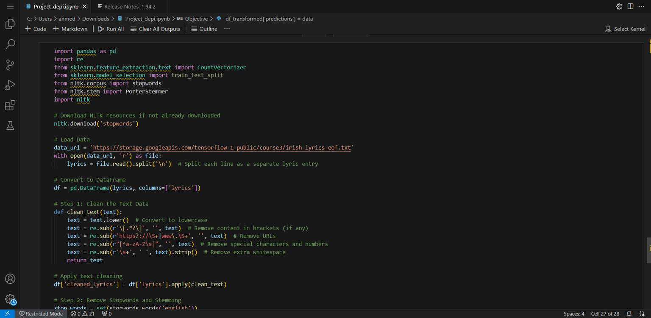

Slide 8
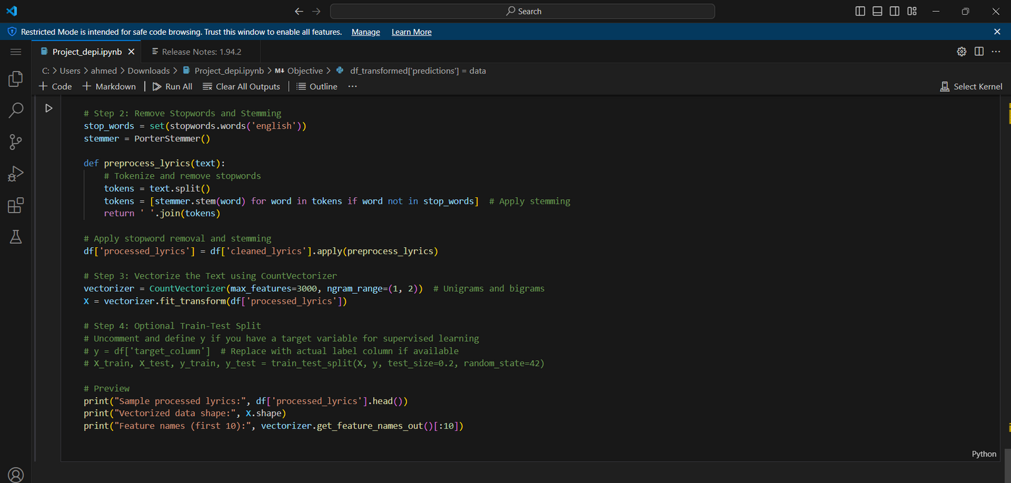

Slide 9
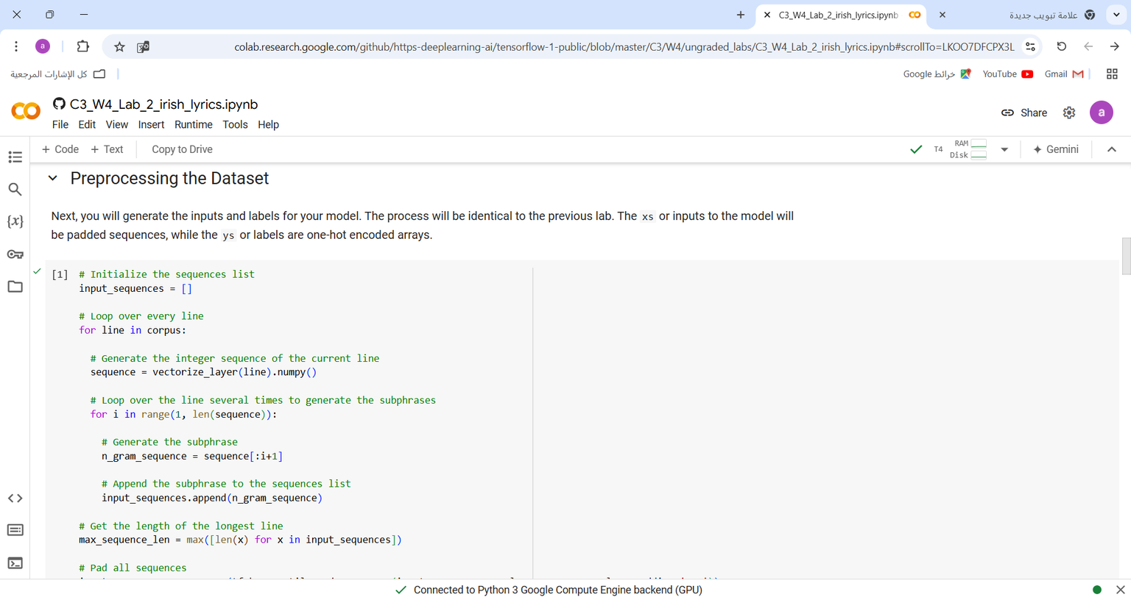

Slide 10
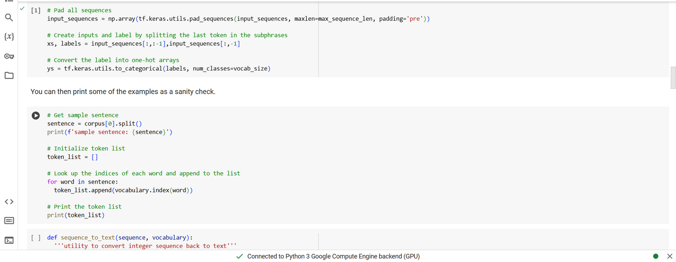

Slide 11
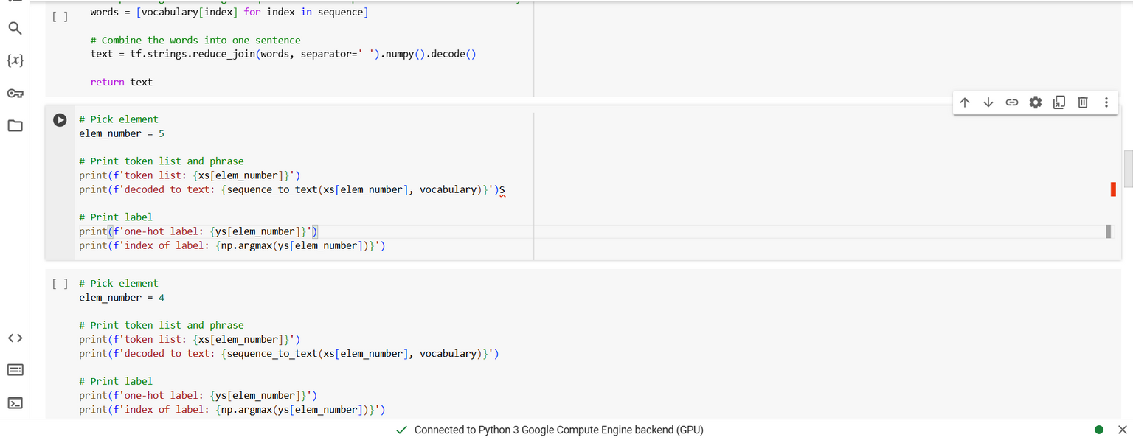

Slide 12


MODEL ARCHITECTURE OVERVIEW
Model Choice: LSTM-based RNN (Recurrent Neural Network).
Layer Structure:
Embedding Layer: Converts tokens into dense vectors representing words, capturing semantic relationships.
LSTM Layers: Sequential LSTM layers to learn temporal dependencies in lyrics.
Dense Layer with Softmax: Outputs probabilities across vocabulary for next-word prediction.
Why LSTM?
Capable of learning dependencies over longer text sequences.
Better at handling context and flow, essential for coherent lyrical generation.

Slide 13
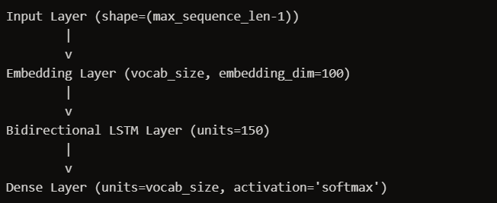

Slide 14
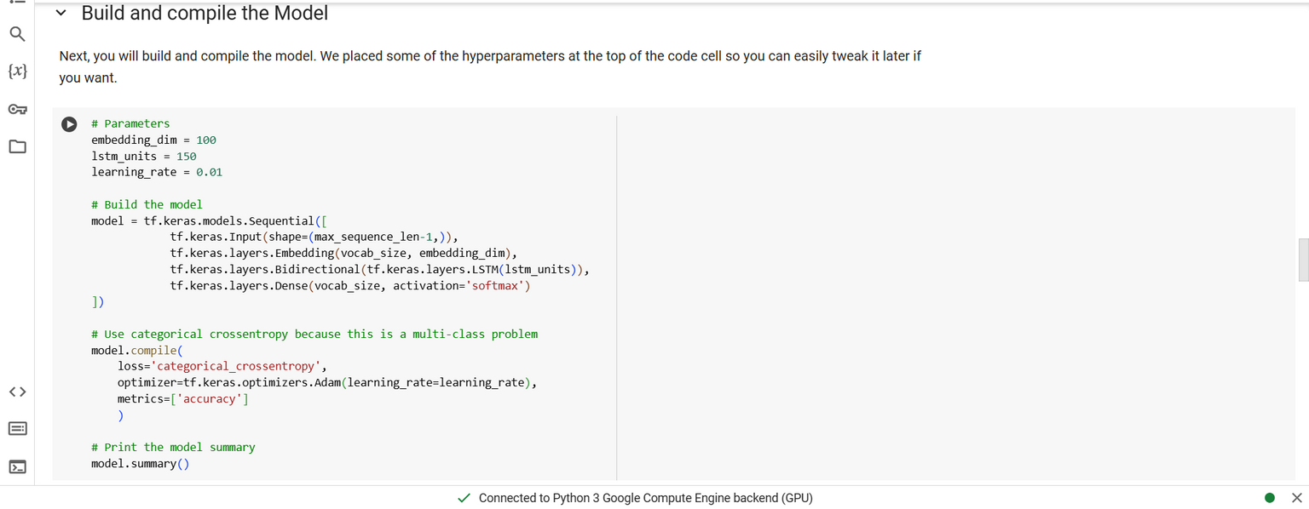

Slide 15

MODEL CONFIGURATION
Hyperparameters:
Embedding Dimension: 100 - To balance information richness with computational efficiency.
LSTM Units: 256 - Chosen to provide depth without overfitting due to small dataset.
Dropout Rate: 0.2 - To prevent overfitting by randomly turning off neurons during training.
Batch Size: 64 - Set to manage computational load while maintaining model robustness.
Learning Rate: 0.001 - Optimized for gradual, steady model convergence.
Optimizer and Loss Function:
Optimizer: Adam - Known for adaptive learning rate adjustments.
Loss Function: Categorical cross-entropy for multi-class prediction.

Slide 16


TRAINING PROCESS AND MODEL PERFORMANCE
Training Approach
Training Metrics
Observations
Ran multiple epochs to allow the model to learn from data patterns.
Monitored validation loss to prevent overfitting.
Loss and Accuracy Over Epochs: Graphical representation to showcase model’s learning curve.
Early Stopping: Implemented to prevent unnecessary training when validation performance plateaus.
Model achieved reasonable accuracy on training data, though challenging to generalize fully due to dataset limitations.

Slide 17
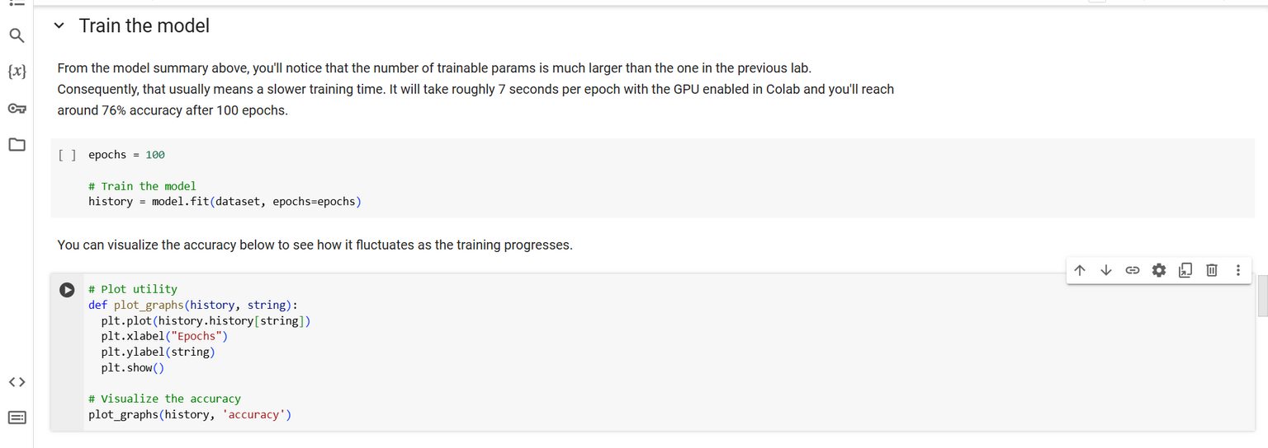

Slide 18

GENERATED TEXT SAMPLES
1
2
3
Analysis of Generated Text:
Coherence: Successfully follows a pattern of Irish folk songs.
Creativity: Shows reasonable diversity in structure but occasionally repeats words.
Limitations in Output: Some sentences may lack creative depth or grammatical correctness, highlighting the model’s sensitivity to input diversity.
SAMPLE 1
SAMPLE 2
Input: "the green fields of" → Generated Text: "the green fields of ireland are calling me home"
Input: "in the morning light" → Generated Text: "in the morning light i sing of our land"

Slide 19
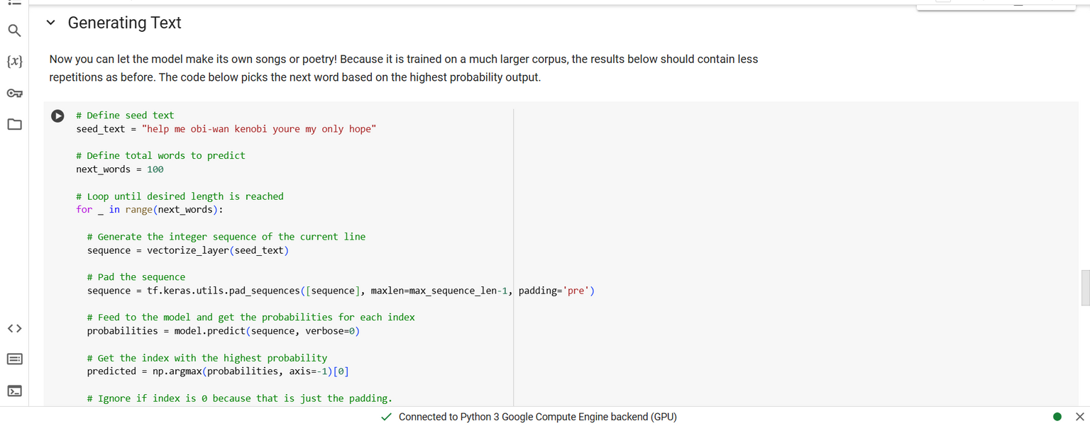

Slide 20

CHALLENGES AND LIMITATIONS
DATASET LIMITATIONS:
SEQUENTIAL MODEL CONSTRAINTS:
TRAINING TIME AND COMPUTATIONAL CONSTRAINTS:
Small dataset may restrict model’s vocabulary and pattern recognition.
RNNs like LSTM sometimes struggle with very long sequences and tend to lose context over time.
Training deep models on large text data can be resource-intensive, impacting development time.

Slide 21
POTENTIAL IMPROVEMENTS
Parameter Tuning: Adjusting hyperparameters like batch size, LSTM units, and embedding dimensions to enhance model stability and accuracy.
Evaluation with BLEU Score: Employ BLEU or similar metrics to quantify the generated text’s quality in comparison to real lyrics.
Dataset Expansion: Adding more Irish lyrics or related English lyrics to increase data variety.
Model Enhancements: Experiment with Transformer-based architectures (e.g., GPT, BERT) for improved text generation.

Slide 22

QUESTIONS AND ANSWER
Summary of Project: Emphasize goal achievement, limitations, and creative applications of ML in cultural projects.
Key Insights:
Deep learning is effective for generating coherent text.
Challenges in small data tasks can inspire innovative solutions.
Future Prospects: Expand beyond lyrics to other text generation tasks, such as poetry or stories.

Slide 23

THANK YOU

